Slide 1


Slide 2

Several times this semester we’ve discussed algorithms – designing, implementing, etc.
The most effective way to solve a problem is to break it into pieces
In C programming we do this with functions
  They should be modular
  They receive values, process them and then optionally return a result
  They should be focused on a simple solution – a singular task
    Calculate interest
    Calculate pay
    Graph values (histogram)
    Open files

Slide 3

Just as we break our C programs into small, defined functions we also break very large applications into small, defined programs
  Some applications (like a “banking” system, a “flight reservation” system, a “university” system) will have 100 programs, 1000 programs, ???
  How are they all tied together?
    The are dependent on one another to operate effectively
    This is no different than you depending on the printf() function – if it doesn’t work right, then your program won’t work right either
To make this work smoothly, you can use the “Make” command

Slide 4

The make command allows you to manage large programs or groups of programs.
  As you begin to write larger programs, you will notice that re-compiling larger programs takes much longer than re-compiling short programs.
  Moreover, you notice that you usually only work on a small section of the program (such as a single function that you are debugging), and much of the rest of the program remains unchanged.

Slide 5

The make program aids you in developing your large programs by keeping track of which portions of the entire program have been changed, compiling only those parts of the program which have changed since the last compile.

Slide 6

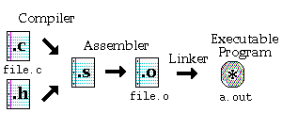
Compiling a small C program requires at least a single .c file, with .h files as appropriate.
Although the command to perform this task is simply cc file.c, there are 3 steps to obtain the final executable program:
  Compile
  Assemble
  Link

Slide 7

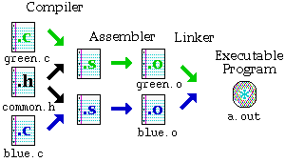
When your program becomes very large, it makes sense to divide your source code into separate, easily manageable .c files
The figure above demonstrates the compiling of a program made up of two .c files and a single common.h file
The command is as follows:
cc green.c blue.c
The two .o files are linked together to create a single a.out file for execution

Slide 8

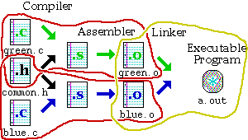
The three different tasks required to produce the executable program are as follows:
Compile green.o: cc -c green.c
Compile blue.o: cc -c blue.c
Link the parts together: cc green.o blue.o

Slide 9

When you separate your C program into many files, keep these points in mind:
  Be sure no two files have functions with the same name in it. The compiler will get confused.
  be sure no two files define the same global variables.
  If you use global variables, be sure only one of the files defines them,
  To use functions from another file, make a .h file with the function prototypes, and use #include to include those .h files within your .c files.
  At least one of the files must have a main() function.

Slide 10

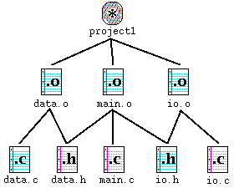
This graph shown in the figure is a program which is made up of 5 source files, called data.c, data.h, io.c, io.h, and main.c.
At the top is the final result, a program called project1.
The lines which radiate downwards from a file are the other files which it depends on.
For example, to create main.o, the three files data.h, io.h, and main.c are needed.

Slide 11

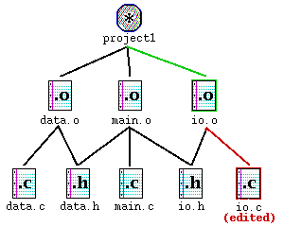
Suppose realize that one function in io.c has a bug in it. You edit io.c to fix the bug.
The figure above shows io.c outlined in red. By going up the graph, you notice that io.o needs to be updated because io.c has changed.
Similarly, because io.o has changed, project1 needs to be updated as well.

Slide 12

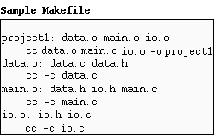
The make program gets its dependency "graph" from a text file called makefile or Makefile which resides in the same directory as the source files.
Make checks the modification times of the files, and whenever a file becomes "newer" than something that depends on it, (in other words, modified) it runs the compiler accordingly.
For example, the previous page explained io.c was changed. If you edit io.c, it becomes "newer" than io.o, meaning that make must run cc -c io.c to create a new io.o, then run cc data.o main.o io.o -o project1 for project1.

Slide 13
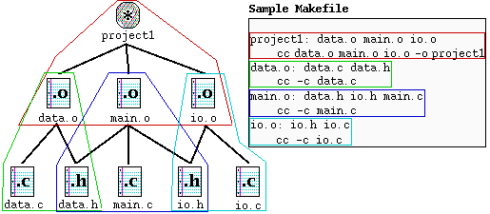
Each dependency shown in the graph is circled with a corresponding color in the Makefile, and each uses the following
format: target : source file(s)
command (must be preceded by a tab)
A target given in the Makefile is a file which will be created or updated when any of its source files are modified.
The command(s) given in the subsequent line(s) (which must be preceded by a tab character) are executed in order to create the target file.

Slide 14
project1: data.o main.o io.o
cc data.o main.o io.o –o project1
data.o: data.c data.h
cc -c data.c
main.o: data.h io.h main.c
cc -c main.c
io.o: io.h io.c
cc -c io.c
Note that in the Makefile shown above, the .h files are listed, but there are no references in their corresponding commands. This is because the .h files are referred within the corresponding .c files through the #include "file.h".
If you do not explicitly include these in your Makefile, your program will not be updated if you make a change to your header (.h) files.

Slide 15

Once you have created your Makefile and your corresponding source files, you are ready to use make.
If you have named your Makefile either Makefile or makefile, make will recognize it. If you do not wish to call your Makefile one of these names, you can use make -f mymakefile.
The order in which dependencies are listed is important. If you simply type make and then return, make will attempt to create or update the first dependency listed.

Slide 16
You can also specify one of the other targets listed in the Makefile, and only that target (and its corresponding source files) would be made. For example, if we typed make, the output of make would look as follows:
% make
cc -c data.c
cc -c main.c
cc -c io.c
cc data.o main.o io.o -o project1
%
When making its targets, make first checks the source files and attempts to create or update the source files. That is why data.o, main.o and io.o were created before attempting to create the target: project1.

Slide 17

This is a BASIC discussion of the make command
You can use macros, special commands and other features to expand and improve the capabilities of the make commands benefits

